Slide 1

Microsoft
Company Name: Microsoft Corporation
Founded: Bill Gates
Chief Executive Officer: Satya Nadella
Date Founded: April 4th , 1975
Ticker: MSFT
Stock Price: 288.30 USD
Market Cap: 2.15 Trillion USD
Recommendation: Buy

Slide 2
Revenue Breakdown
Windows | Office | Azure | Microsoft Dynamics 365 | Microsoft Surface | Microsoft Enterprise Service | Bing | LinkedIn | Xbox
14.43% | 23.79% | 31.34% | 2.13% | 5.84% | 4.41% | 5.16% | 6.16% | 9.11%
Windows is a popular operating system developed by Microsoft Corporation. It provides a graphical user interface, supports various file formats, built-in tools for managing files and folders, and connecting to networks. Widely used for personal and business purposes, Windows is a fundamental part of modern computing. | Microsoft Office is a suite of productivity applications developed by Microsoft Corporation. It includes applications such as Word, Excel, PowerPoint, and Outlook. These applications are used to create, edit, and manage documents, spreadsheets, presentations, and emails. Microsoft Office is widely used by businesses and individuals worldwide. | Azure is a cloud computing platform developed by Microsoft Corporation. It provides a wide range of services, including computing, storage, analytics, and networking. Azure enables businesses to create, deploy, and manage applications and services in the cloud. It is used by businesses of all sizes to improve efficiency, scalability, and cost-effectiveness. | Microsoft Dynamics 365 is a cloud-based enterprise resource planning (ERP) and customer relationship management (CRM) software platform. It integrates a range of business applications, including sales, marketing, finance, supply chain, and operations. Dynamics 365 enables businesses to manage their operations and customer relationships more efficiently and effectively. | Microsoft Surface is a line of touchscreen-based personal computers and interactive whiteboards designed and developed by Microsoft. It features a range of devices, including the Surface Pro tablets, Surface Laptop, Surface Studio, Surface Hub, and Surface Book, with a focus on versatility, productivity, and portability. | Microsoft Enterprise Services offers a wide range of consulting, support, and managed services to help organizations enhance their digital transformation and cloud computing capabilities. They provide solutions for data management, cybersecurity, AI, and IoT to improve business productivity, agility, and innovation. | Bing is a search engine developed by Microsoft that provides web search, image search, video search, news aggregation, and maps functionalities. It uses AI algorithms to deliver personalized search results and supports voice and image search. Bing also powers the search function on Microsoft's Edge browser and Windows operating system. | LinkedIn is a social networking platform focused on professional networking and career development. It allows users to connect with colleagues, find job opportunities, and access industry news and insights. LinkedIn offers features such as job posting, advertising, and talent solutions for businesses to recruit and manage their workforce effectively. | Xbox is a gaming brand developed by Microsoft that includes a range of gaming consoles, accessories, and online services. Xbox provides a variety of games and entertainment options, including single-player and multiplayer games, streaming services, and game development tools. Xbox Live is a subscription-based service that enables users to play online and access exclusive content.

Slide 3
Business Model
Microsoft's business model centers around selling software and cloud services to both businesses and consumers. Revenue is generated through product sales, licensing fees, subscriptions, and pay-as-you-go cloud services. Key elements include the sale of software products such as Windows and Microsoft Office, licensing fees for software products, cloud computing through Azure and Office 365, and a shift towards subscription-based services for some software products. Microsoft has a diverse product portfolio and a strong presence in many markets, including enterprise software, cloud computing, gaming, and mobile devices.
Catalysts
Microsoft's potential catalysts include the growth of its cloud computing platform, investments in artificial intelligence and machine learning technologies, growth in its gaming business, continued adoption of its productivity and collaboration tools, and strategic acquisitions.
Competitive Advantage
Microsoft's partnership with OpenAI has resulted in the development of a new generative AI technology that speeds up AI production. The company's R&D spending in 2022 was $19.27 billion, primarily used to develop new software and hardware products and improve existing ones. Microsoft is working on several initiatives, including Microsoft Mesh, Azure Quantum, Microsoft Viva, and Windows 11, which are expected to shape the future of the technology industry. The partnership with OpenAI is expected to lead to the development of new AI models and applications that can be used in various industries, making Microsoft a key player in the field of AI.

Slide 4
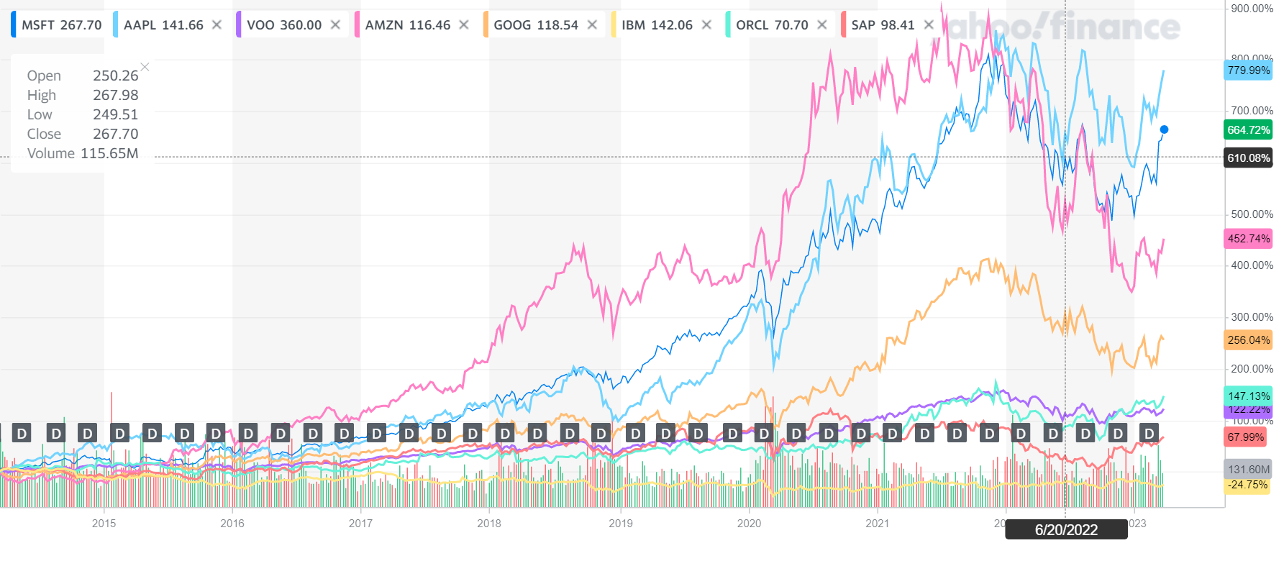
Stock Prices Relative To Other Companies

Slide 5
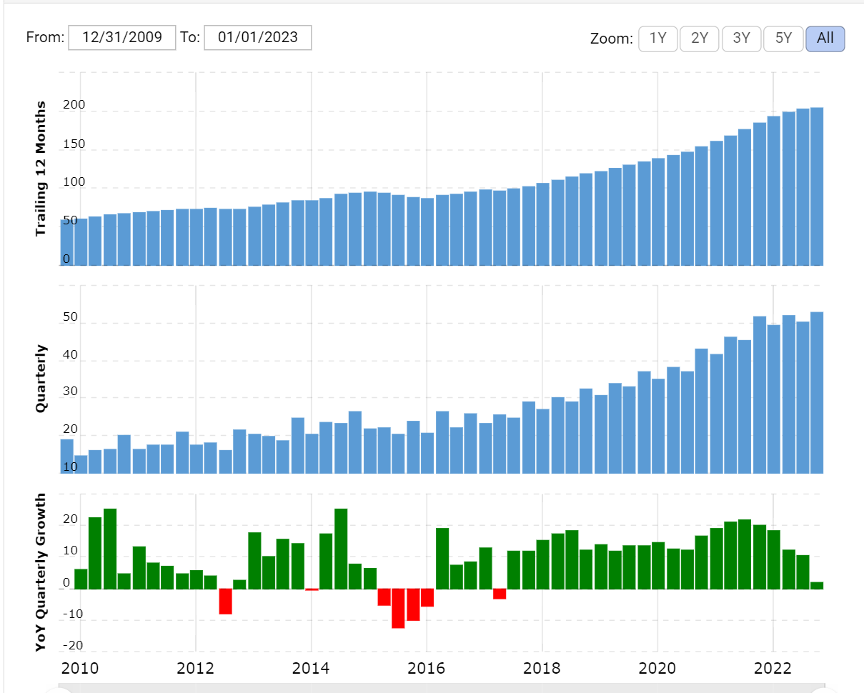
Revenue Growth

Slide 6
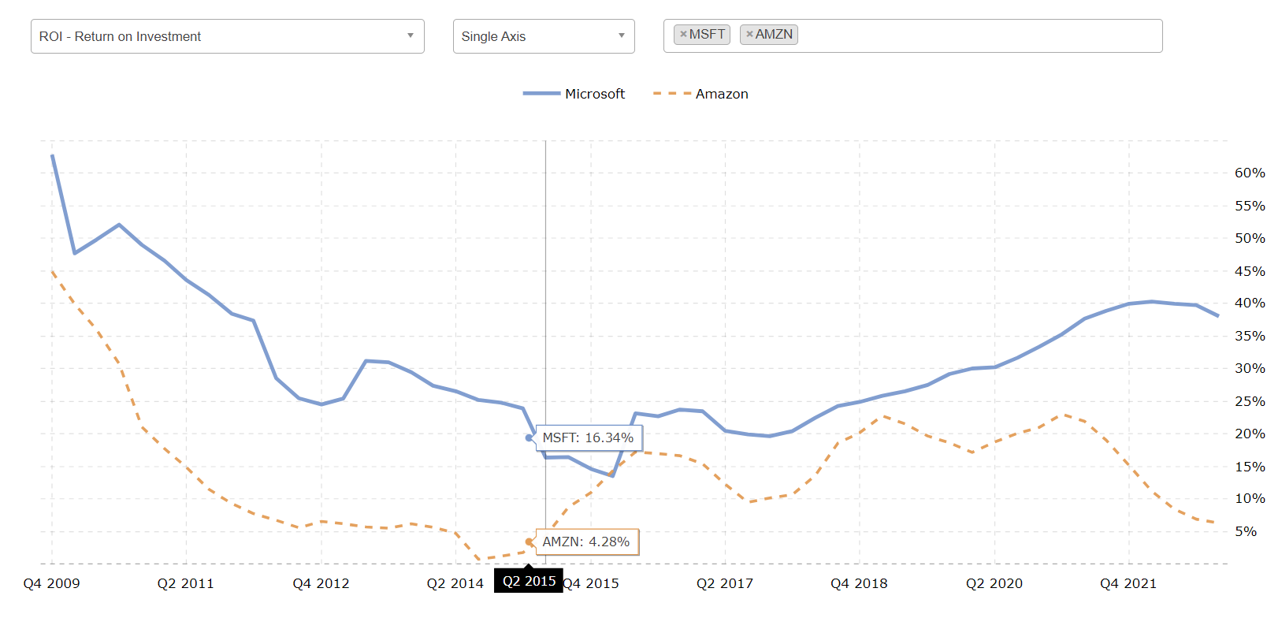
Return on Investment ( Microsoft Vs Amazon)

Slide 7
Income Statement Analysis
In 2022, Microsoft reported strong income statement statistics, including revenue of $198 billion, net income of $72.7 billion, and an operating margin of 42%. These figures reflect the company's ability to generate substantial profits while operating efficiently. Microsoft's diverse revenue stream and commitment to cost management are positive signs for investors, indicating a financially robust company committed to long-term value creation.
Balance Sheet Analysis
Microsoft reported impressive financial figures for the year 2022, indicating a strong financial position. The company reported a net income of $72.7 billion, a significant increase from the previous year, and had an operating cash flow of $89 billion. Microsoft made payments to investors totaling $50.8 billion, including dividends and share repurchases, highlighting its commitment to returning value to shareholders. The company's operating margin was 42%, indicating efficient cost management and strong profitability. Microsoft's balance sheet totaled $365 billion, reflecting a strong asset base. Overall, these metrics demonstrate that Microsoft is in a solid financial position with substantial assets and the ability to invest in growth initiatives.
Cash-Flow Analysis
Microsoft's 2022 cash flow statistics demonstrate the company's strong financial position. The company generated $89.035 billion in cash flow from operating activities, indicating efficient cash generation from its core business. Although the company had a cash outflow of $30.311 billion from investing activities, this suggests Microsoft is focused on expanding its operations and investing in growth initiatives. The company's total depreciation and amortization-cash flow of $14.46 billion reflects its investment in fixed assets and intangible assets. Overall, these metrics demonstrate that Microsoft is a financially robust company committed to long-term value creation.

Slide 8
Valuation Statistics
Introduction Microsoft is one of the leading technology companies globally, providing software, hardware, and cloud computing services to customers across various industries. In this report, we will analyze Microsoft's risk-free rate, beta, and weighted average cost of capital (WACC) as of June 2022, based on available financial data.
Risk-Free Rate and Cost of Debt As of June 2022, Microsoft's interest expense was $2063 million, and its total book value of debt was $64522.5 million. Based on this data, the cost of debt was calculated to be 3.1973%. The current risk-free rate is 3.473%, which means that Microsoft's cost of debt is lower than the current risk-free rate. This indicates that Microsoft is a low-risk company in terms of its debt obligations.
Microsoft's beta was 0.93 as of 2021. This means that Microsoft's stock price is less volatile than the overall market. A beta of less than 1 indicates that the stock is less risky than the market, and a beta greater than 1 indicates that the stock is more volatile than the market.
Weighted Average Cost of Capital Microsoft's weighted average cost of capital (WACC) was 9.75% as of 2023. WACC is a calculation of a company’s cost of capital in which each category of capital is proportionately weighted. The WACC considers the cost of equity and the cost of debt. The cost of equity is influenced by the risk-free rate, the market risk premium, and the company's beta.
PE Value As of March 28th, 2023, Microsoft's intrinsic value calculated from the discounted cash flow (DCF) model is $249.05. This indicates that Microsoft's current stock price may be undervalued, and the company's financial performance may improve in the future.
Conclusion Based on the available financial data, Microsoft's risk-free rate is lower than the current risk-free rate, indicating that it is a low-risk company in terms of its debt obligations. Microsoft's beta is less than 1, indicating that the stock is less volatile than the market. Microsoft's WACC was 9.75% in 2023, which takes into account the cost of equity and debt. Lastly, the DCF model suggests that Microsoft's intrinsic value is $249.05 as of March 28th, 2023, indicating that the company's financial performance may improve in the future.

Slide 9
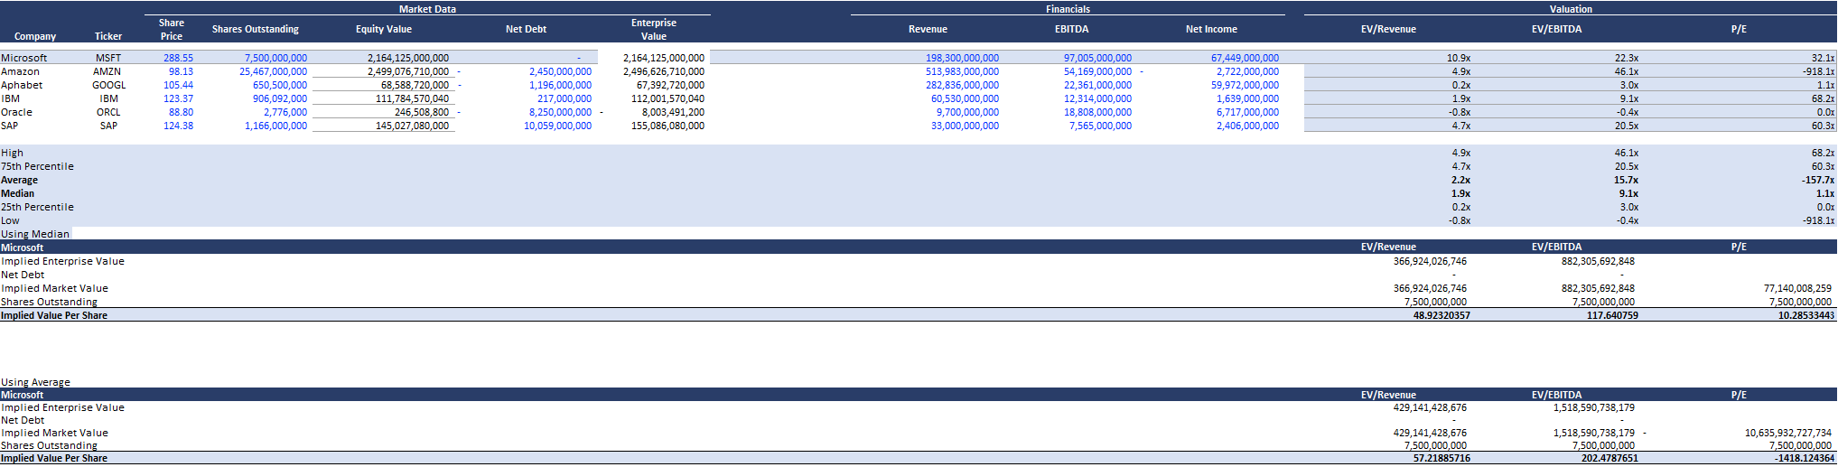
Comparable Company Analysis

